Slide 1




⁵ᵗʰ International Conference on Intelligent Systems and Machine Learning (ICISML-2025)
Organized
by
Department of Computer Science & Engineering, NIT Meghalaya, India
Paper Title : Depression Detection with Hybrid Machine Learning Approach on Twitter Data
Authors: Sachi Nandan Mohanty, VIT-AP University, Andhra Pradesh, India
Tamanna Jena, Fairleigh Dickinson University, Vancouver, Canada.
Ishan Das, VIT-AP University, Andhra Pradesh, India
Abhilipsa Padhy, VIT-AP University, Andhra Pradesh, India
Paper id: 30
1

Slide 2
Plan of Presentation
Introduction
Related work
Proposed Model
Methodology
Results & Discussion
Future scope
Conclusion
References
2

Slide 3
Introduction
Mental health significantly affects quality of life, with disorders like depression impacting millions globally. Social media platforms, especially Twitter, provide a valuable source of real-time data for mental health monitoring, as users often express emotions and experiences through tweets. Analyzing this unstructured, noisy, and informal data poses challenges due to its colloquial language, emojis, and abbreviations. Traditional machine learning methods like SVMs and Random Forests often struggle to capture the contextual and semantic nuances of such posts.
This study proposes a hybrid deep learning framework for depression detection, integrating convolutional, sequential, and attention layers. The three models—ConvBiLSTM-AttnNet, ConvLSTM-AttentionNet, and HybridNet—utilize Conv1D layers, bidirectional LSTMs, and custom attention mechanisms for robust feature extraction and interpretation. Enhancements include LDA topic modeling and emoji sentiment analysis, capturing thematic insights and emotional context.
Among the models, ConvBiLSTM-AttnNet achieves an AUC of 96%, combining spatial, sequential, and attention-based learning, while ConvLSTM-AttentionNet reaches 87% accuracy. The AdamW optimizer further enhances generalization with low weight decay. This research represents a significant advancement in depression detection by leveraging hybrid deep learning architectures to analyze the multidimensional complexity of social media data effectively. Future directions involve refining models and expanding applications in public health.
3

Slide 4
Related work
Existing literature highlights the diverse applications and challenges of machine learning algorithms across domains. Lei Liu showcased Logistic Regression's simplicity and interpretability in breast cancer diagnosis, achieving over 85% accuracy, though limited in handling non-linear data. Decision Trees, explored by Kappali and Deshpande in PV system voltage control, demonstrated interpretability and efficiency for non-linear data, with accuracies of 75-80%. Naive Bayes, applied by Hong Chen in traffic risk management, excelled in high-dimensional text analysis, despite its independence assumption limiting accuracy to 80%.
KNN, highlighted by Rawat for breast cancer diagnosis, showed simplicity but struggled with computational intensity in high-dimensional spaces, capping accuracy at 75-80%. RNNs, praised by Klugman for capturing temporal dependencies, achieved 85-89% accuracy despite the vanishing gradient issue. PCA improved computational efficiency in dimensionality reduction, as noted by Sehgal, with 80-85% accuracy but reduced interpretability.
Advanced methods like Autoencoders (89%) and Deep Belief Networks (88-90%), explored by Tomar and Mohamed, excelled in complex, high-dimensional tasks but required significant resources. Clustering methods like K-Means and Hierarchical Clustering remained popular for simplicity but struggled with scalability. Federated Learning achieved 87-90% accuracy in privacy-sensitive tasks despite implementation challenges.
These studies emphasize both the promise and limitations of machine learning techniques, guiding future innovation.
4

Slide 5
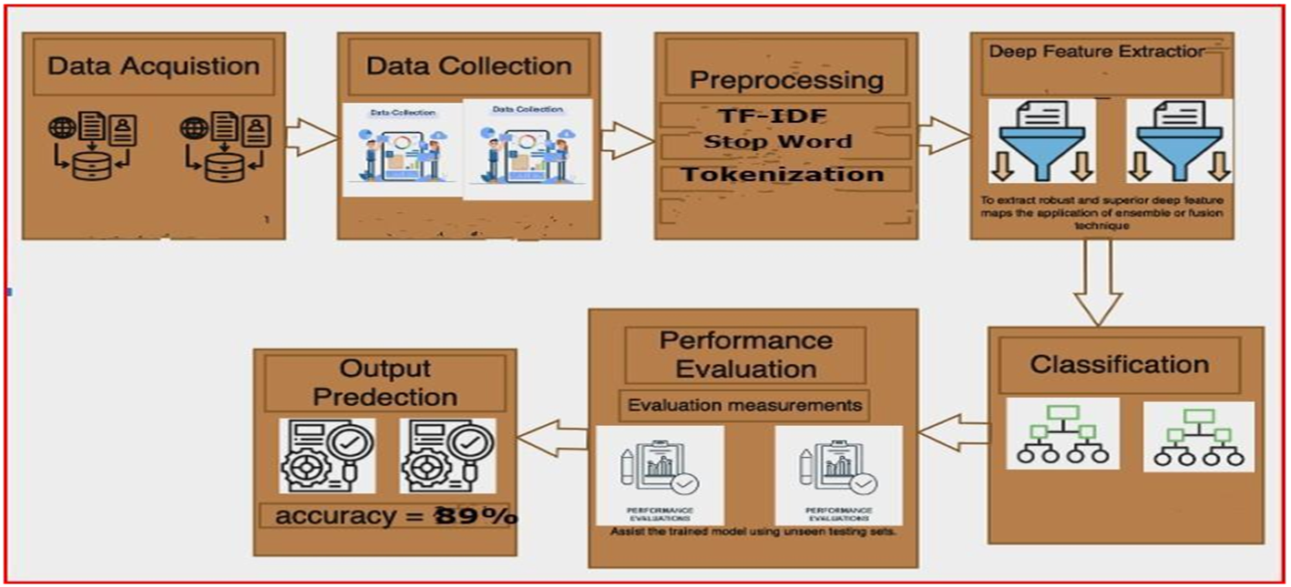
Proposed Model
5

Slide 6
Methodology
This study explores three hybrid deep learning models, each designed to capture different aspects of Twitter data for depression detection. Below is a description of each model's architecture and its key components.
1.ConvBiLSTM-AttnNet
Embedding Layer: Converts tokens into 128-dimensional word embeddings to represent semantic information.
Convolutional Block: A 1D convolutional layer with 64 filters captures local word patterns in tweets. This is followed by a second Conv1D layer with 128 filters, enhancing feature extraction.
Batch Normalization: Stabilizes the training process and accelerates convergence.
Global Max Pooling: Reduces the dimensionality by retaining the most relevant features.
Bidirectional LSTM with Attention Mechanism: A Bidirectional LSTM layer (64 units) captures sequential dependencies from both directions, while an attention mechanism emphasizes significant features, making the model more interpretable.
Fully Connected Layers: Two dense layers with 128 and 64 units, each followed by a 60% dropout rate to prevent overfitting.
Output Layer: A final dense layer with sigmoid activation outputs probabilities for binary classification.
6

Slide 7
2. ConvLSTM-AttentionNet
Embedding Layer: Maps each word into a 128-dimensional vector, creating dense representations of the tweets.
Convolutional Block: Two Conv1D layers (64 and 128 filters) capture local textual features, followed by batch normalization and global max pooling to focus on key features.
Reshape Layer: Prepares the output of the convolutional block for the sequential layer.
LSTM with Attention Mechanism: A Bidirectional LSTM layer with 64 units captures the temporal sequence of words, while an attention layer highlights the most important words, aiding interpretability.
Fully Connected Layers: Two dense layers with 128 and 64 units, each followed by a 60% dropout rate for regularization.
Output Layer: A dense layer with sigmoid activation provides the binary classification result.
7

Slide 8
3. HybridNet
Embedding Layer: Transforms tokens into 128-dimensional embeddings, enriching the semantic understanding of tweets.
Convolutional Block with L2 Regularization: Two Conv1D layers with 64 and 128 filters use L2 regularization to prevent overfitting. Batch normalization further stabilizes training, and global max pooling extracts key features.
Bidirectional LSTM with Attention Mechanism: A 64-unit Bidirectional LSTM captures bidirectional dependencies, while an attention mechanism selectively emphasizes key parts of the sequence.
Fully Connected Layers: Two dense layers with 128 and 64 units, with 60% dropout to enhance model robustness and reduce overfitting.
Output Layer: A sigmoid-activated dense layer produces the binary classification probability.
8

Slide 9
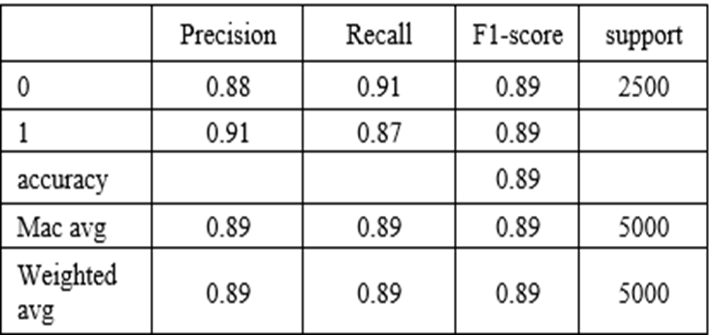
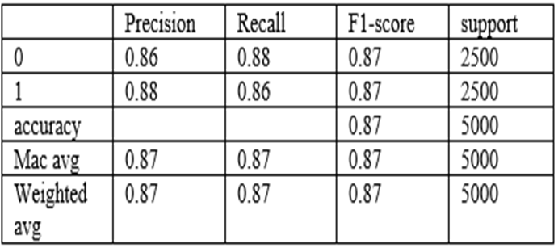
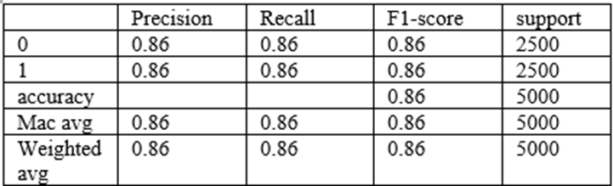
Results & Discussion
Table1: Classification Report of ConvBiLSTM-AttnNet
Table2: Classification Report of ConvLSTM-AttentionNet
Table3: Classification Report of HybridNet
9

Slide 10
Future scope
While our hybrid deep learning framework for depression detection using Twitter data has demonstrated strong performance, several avenues exist for further advancement. Future research could benefit from expanding the dataset to include a more diverse and representative sample of social media users, as well as incorporating data from multiple platforms such as Reddit, Instagram, and Facebook. This would enable the development of models that generalize better across varied linguistic styles and emotive expressions.
To enhance model robustness and contextual understanding, future work could explore transformer-based architectures and graph neural networks. These models are well-suited for capturing long-range dependencies and complex semantic relationships within text. Integrating multimodal features, such as images or user metadata, may further enrich classification accuracy.
Given the evolving nature of social media language, incorporating adaptive embedding techniques (e.g., contextualized word embeddings and real-time slang updates) will be vital for maintaining model relevance. Additionally, multilingual support should be prioritized to ensure applicability across different linguistic and cultural contexts.
Real-time depression detection systems hold promise for timely intervention. Deploying models capable of continuously analyzing streaming social media content could provide early alerts to mental health professionals or trusted networks.
Finally, explainable AI (XAI) techniques such as attention visualization, SHAP, or LIME can offer transparency in predictions, helping clinicians interpret results and fostering trust in AI-assisted mental health diagnostics. Combining these innovations can establish scalable, ethically responsible, and clinically valuable systems for monitoring mental health on digital platforms.
10

Slide 11
Conclusion
This study introduces a comprehensive approach to detecting depressive indicators in Twitter data using hybrid deep learning models. By combining convolutional, recurrent, and attention layers, the ConvBiLSTM-AttnNet model achieved the highest AUC and accuracy, highlighting its robustness in capturing complex textual patterns. This scalable solution offers potential for real-time mental health monitoring, aiding clinicians and researchers in identifying at-risk individuals.
Future research could enhance model generalizability by utilizing diverse, multi-platform datasets (e.g., Reddit, Instagram) and addressing additional mental health conditions. Advanced architectures like transformers and graph-based neural networks could further improve contextual understanding. Incorporating real-time adaptations for evolving social media language and developing multilingual capabilities would enhance global applicability.
Explainable AI techniques, such as SHAP or LIME, could increase transparency, allowing professionals to interpret model predictions effectively. This study lays the foundation for scalable, ethical mental health monitoring, with significant potential for clinical and public health applications.
11

Slide 12
References
L. Liu, "Research on Logistic Regression Algorithm of Breast Cancer Diagnose Data by Machine Learning," 2018 International Conference on Robots & Intelligent System (ICRIS), Changsha, China, 2018, pp. 157-160, doi: 10.1109/ICRIS.2018.00049.
Brandon A. Kohrt1,2, Nagendra P. Luitel1* Abstract, Prakash Acharya1 and Mark J. D. Jordans1,3,4
Kailai Yanga, Tianlin Zhanga, Sophia Ananiadoua,b,
Learning Riya Aggarwal 1Computer Science and Engineering, Amity University Noida, Uttar Pradesh, India 1riyaagg09@gmail.com Anjali Goyal2 2 School of Engineering and Technology, Sharda University Greater Noida, Uttar Pradesh, India
A. Deshpande and M. Kappali, "Coordination of Energy Storage Systems and Closed Loop Converter for Regulating Voltage of PV System," 2020 IEEE International Conference on Electronics, Computing and Communication Technologies (CONECCT), Bangalore, India, 2020, pp. 1-5, doi:10.1109/CONECCT50063.2020.9198444.
Genaro K, Fabris D, Arantes ALF, Zuardi AW, Crippa JAS, Prado WA. Cannabidiol Is a Potential Therapeutic for the Affective-Motivational Dimension of Incision Pain in Rats. Front Pharmacol. 2017 Jun 21;8:391. doi: 10.3389/fphar.2017.00391. PMID: 28680401; PMCID: PMC5478794.
Chen X, Li X, Zhang JJ, Han Y, Kan J, Chen L, Qiu C, Santoso T, Paiboon C, Kwan TW, Sheiban I, Leon MB, Stone GW, Chen SL; DKCRUSH-V Investigators. 3-Year Outcomes of the DKCRUSH-V Trial Comparing DK Crush With Provisional Stenting for Left Main Bifurcation Lesions. JACC Cardiovasc Interv. 2019 Oct 14;12(19):1927-1937. doi: 10.1016/j.jcin.2019.04.056. Epub 2019 Sep 11. PMID: 31521645.
Hong Chen and Songhua Hu contributed equally to this work and should be considered co-first authors. 3School of Mathematic and Statistic, Hubei University of Science and Technology, Xianning, China Full list of author information is available at the end of the article
12

Slide 13
Thank you
13

